Slide 1
Red hat Installation 2
Live CD

Slide 2
If you find a problem try this :
  Go to “BOIS Setup”
  Then select “System Configuration” from the menu
  Enable the “virtualization technology”

Slide 3
Live CD
A live CD, live DVD, or live disc is a complete bootable computer operating system which runs in the computer's memory, rather than loading from the hard disk drive.
It allows users to experience and evaluate an operating system without installing it or making any changes to the existing operating system on the computer.
Live CDs are unique because they can run on a computer lacking secondary storage, such as a hard disk drive, or with a corrupted hard disk drive or file system, allowing users to rescue data.

Slide 4
CentOS
CentOS is an Enterprise Linux distribution based on the sources from Red Hat Enterprise Linux

Slide 5
Download an iso image using uTorrent or by direct link.
  For 64 bit OS
  CentOS-6.3-x86_64-LiveCD.iso
  CentOS-6.3-x86_64-LiveCD.torrent
  For 32 bit OS
  CentOS-6.3-i386-LiveCD.iso
  CentOS-6.3-i386-LiveCD.torrent

Slide 6
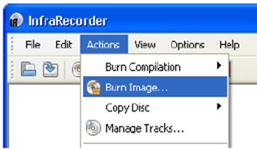
Burn your CD
An ISO image file is an exact image of what needs to be on the CD/DVD. Putting that image on a CD/DVD involves a different process than copying files to a CD/DVD.
To burn an ISO image to CD/DVD you can use the following program :
InfraRecorder http://infrarecorder.org/?page_id=5
Inter your CD drive then restart your computer.

