Slide 1

Red Hat Installation

Slide 2
Installing Red Hat Linux is the process of copying operating system files from a CD, DVD, or USB flash drive to hard disk(s) on a system and setting up configuration files so that Linux runs properly on the hardware.
Types of installations:
Fresh installations
Upgrades from older releases of Ubuntu Linux
Dual-boot installations.
Virtual Machine

Slide 3
Fresh installations
  An installation, sometimes referred to as a clean install, writes all fresh data to a disk. The installation program overwrites all system programs and data as well as the kernel.
Dual-boot installations
  is one that can boot one of two (or more) operating systems.

Slide 4
Virtual Machine (VM)
A virtual machine (VM) is a "completely isolated guest operating system installation within a normal host operating system“
Virtualization lets you run multiple virtual machines on a single physical machine, with each virtual machine sharing the resources of that one physical computer across multiple environments.

Slide 5
Virtual Machines Benefits
  Compatibility: Virtual machines are compatible with all standard x86 computers
  Isolation: Virtual machines are isolated from each other as if physically separated
  Encapsulation: Virtual machines encapsulate a complete computing environment
  Hardware independence: Virtual machines run independently of underlying hardware

Slide 6
Installation Steps
Download an ISO image of Red Hat Enterprise Linux 6 using a uTurrent
Download Oracle VM VirtualBox
Create a New VM.
Start a Red Had in a VM.

Slide 7
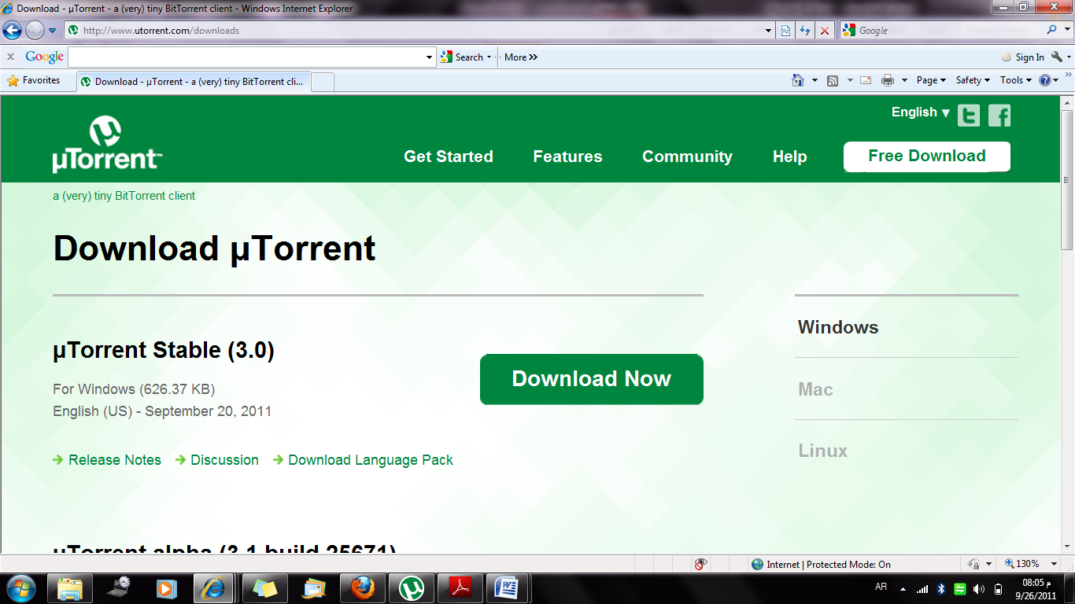
Download Torrent
http://www.utorrent.com/downloads

Slide 8
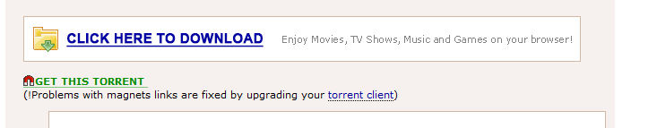
For 64 bit Operating System:
For 32 bit Operating System:
http://thepiratebay.se/torrent/6107499
-After saving the file , the torrent will open automatically.
-The downloaded file is an ISO image.

Slide 9
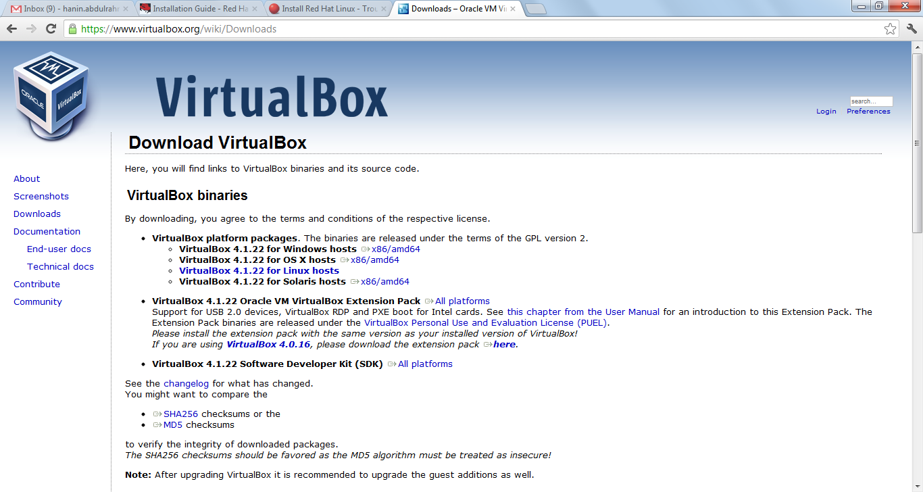
Download Oracle VM VirtualBox
https://www.virtualbox.org/wiki/Downloads

Slide 10
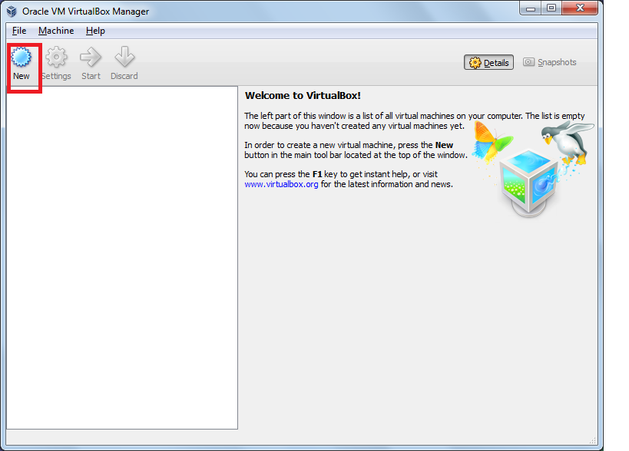
Open the Oracle VM VirtualBox , then click new
Click Next.

Slide 11
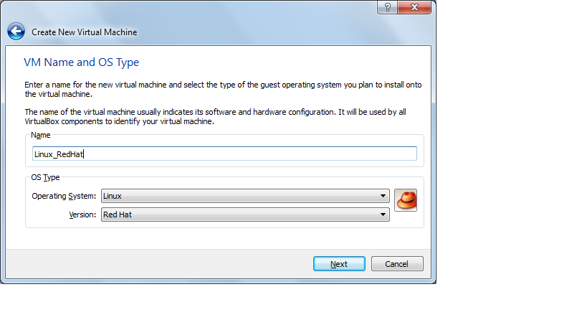
Write a name for the new VM and choose the OS type.

Slide 12
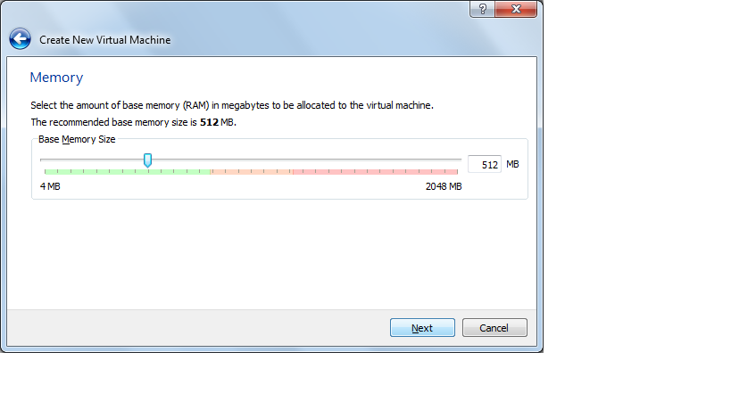
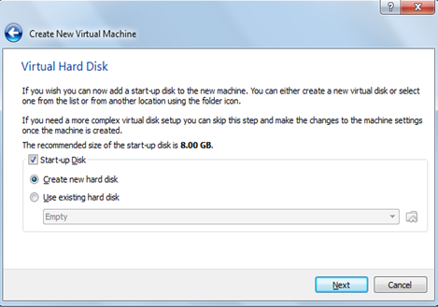
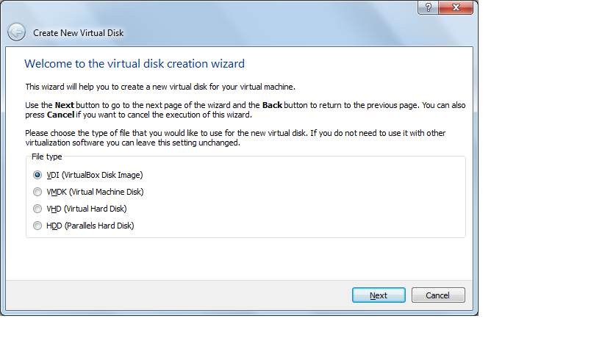
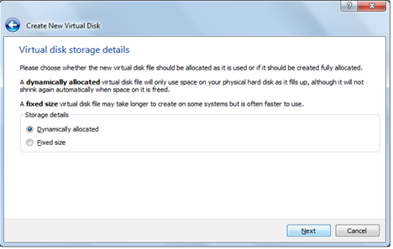
Click Next

Slide 13
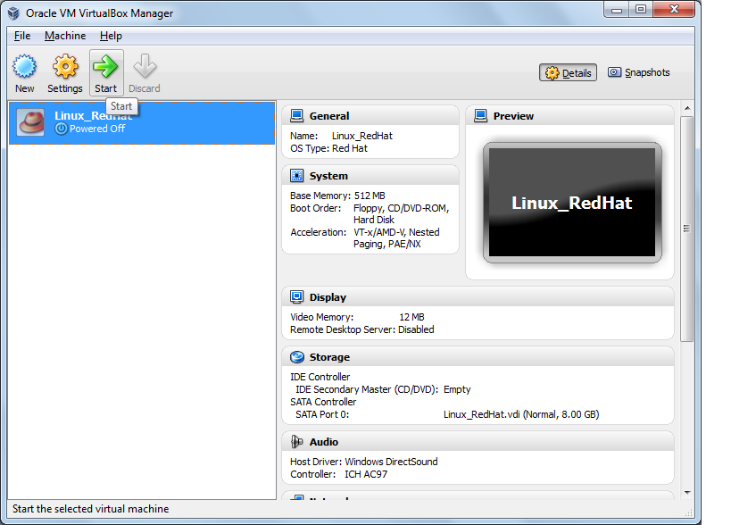
After you create a new VM click Start

Slide 14
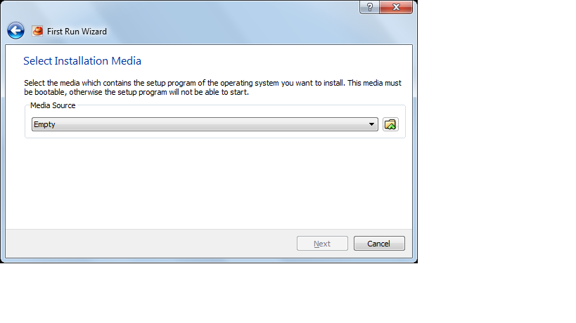
Browse for an ISO image of the Red Hat

Slide 15
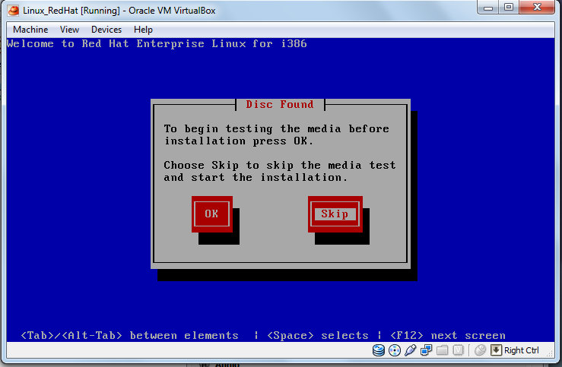
Click Skip

Slide 16
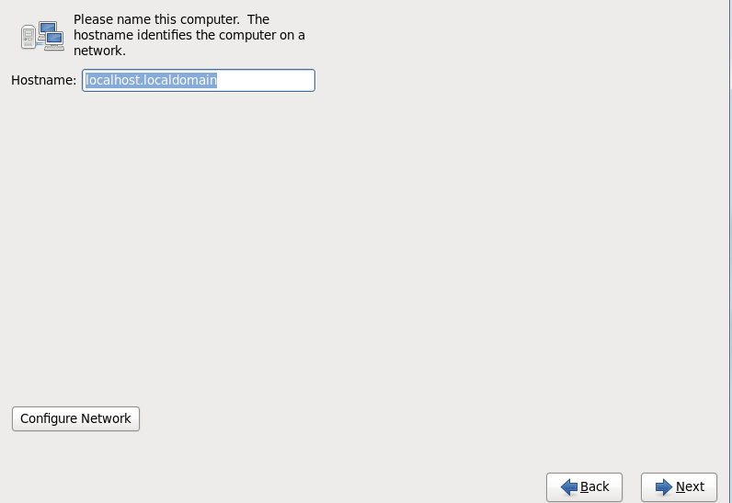
Click Next

Slide 17
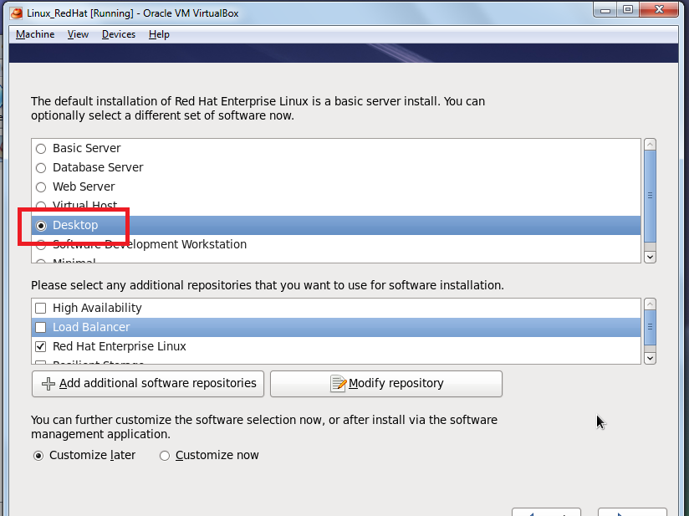
Choose a Desktop then click Next

Slide 18
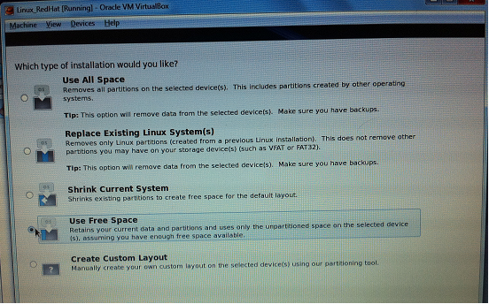
Click Use a Free Space.

Slide 19
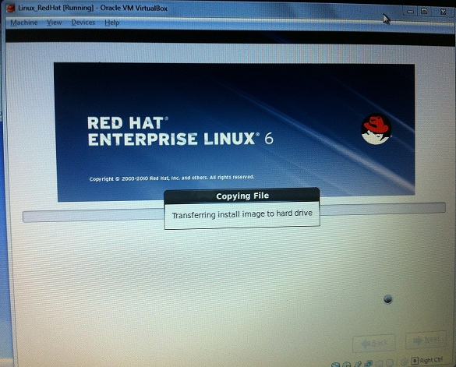
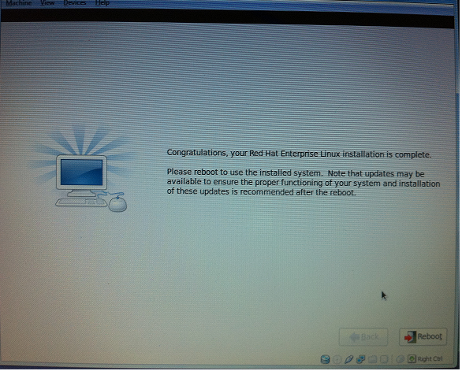
Click Reboot

Slide 20
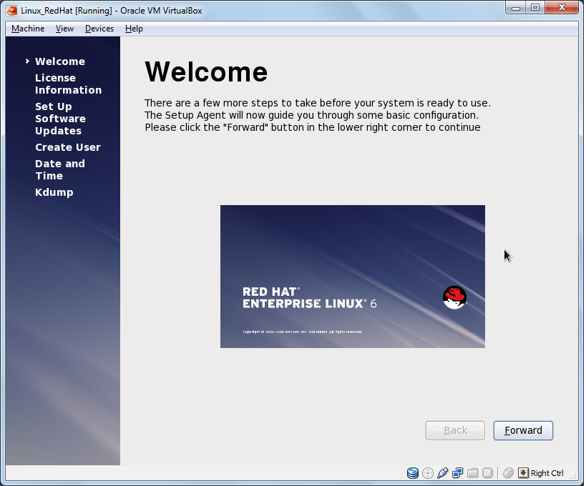
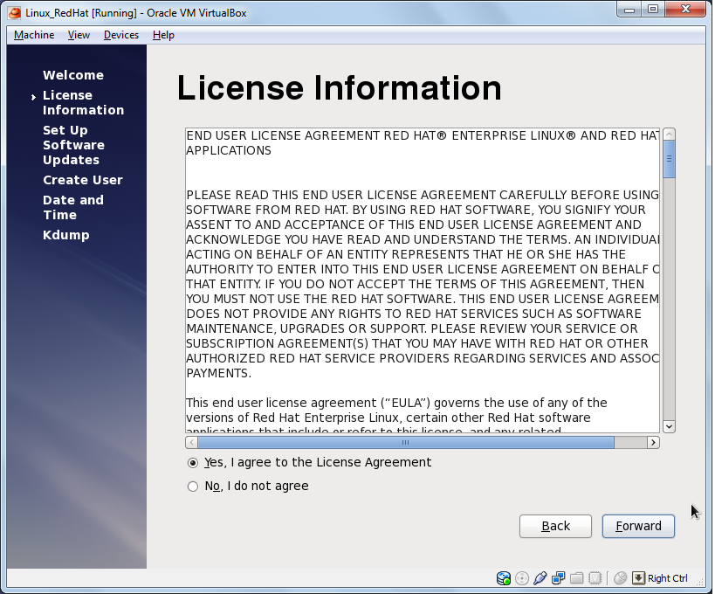
Click Forward for the next windows

Slide 21
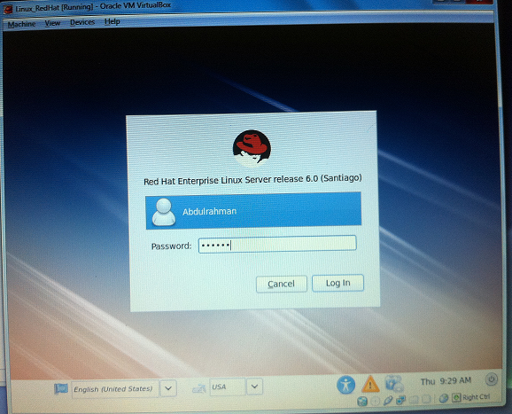
Enter your Password

Slide 22
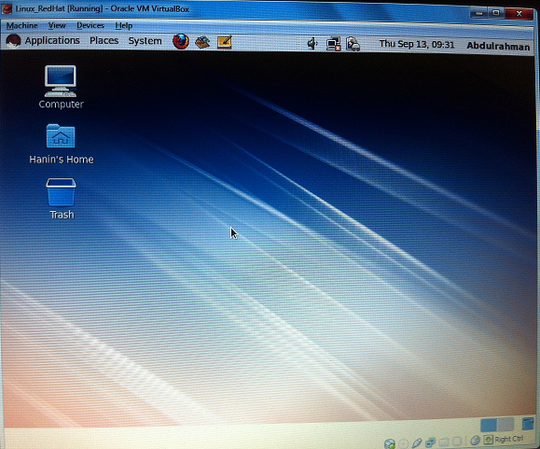

Slide 23
References
http://www.youtube.com/watch?v=fMb5rS4EPlw
http://en.wikipedia.org/wiki/Virtual_machine
http://www.redhat.com/

